Slide 1
2020 Census: Who is Counted?
The Census counts all persons who live in the United States on April 1, 2020, regardless of citizenship or immigration status
The citizenship question is not on the 2020 Census
People are counted at their “usual place of residence”
Notes:
At their “usual place of residence” (where they live & sleep most of the time)
College students living away from home at their college residence
Incarcerated persons at the prison/jail facility
People experiencing homelessness (1) Service-based Enumeration; (2) Enumeration of Transitory Locations; or (3) at the home where they are staying, however temporary, if there is no other “usual residence”
Note: April 1, 2020 is a reference date only – it is not when the Census starts! There is a timeline later in this slide deck. This is used to help people understand how they should be counted.

Slide 2
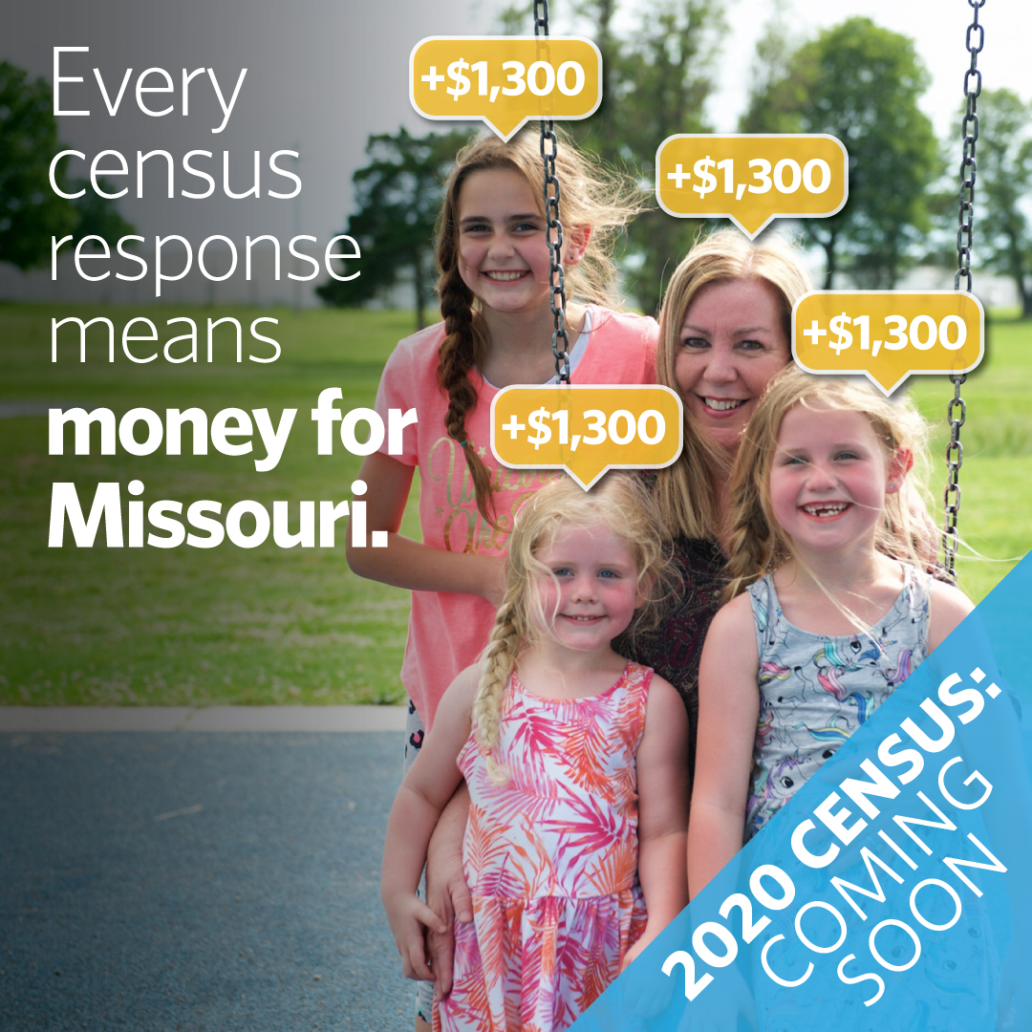
Why it Matters to Missouri
Distribution of federal resources
How congressional seats are decided
Accurate data for strategic decision-making
Notes:
The goal for Census 2020 is to have an accurate count – there are multiple reasons for a complete count and it’s likely one of the reasons will be compelling for you.
Census data determines a fair allocation of federal funds; fair congressional representation; and provides fair and accurate data to be used for essential planning and decision-making. This data guides philanthropy, government (local, state and federal), and business strategies, investments, and evaluations.

Slide 3
Why it Matters to You
When we all respond, Missouri gets more money to pave our roads and rebuild bridges.
When we all respond, our health care programs and community health centers get more funding to take
care of our family, friends, and neighbors. When we’re not all counted, hospitals could close, forcing people to drive hours to get care.
When we all respond, our schools get important funding to take care of our kids. This includes afterschool programs and lunches for children.
Notes:
The Census funds a number of projects that are connected to our day to day lives. Missouri Foundation for Health conducted research here in Missouri to better understand what is most likely to motivate someone to respond to the Census. These are the top three reasons: funding for our roads, our hospitals and health care centers, and our schools.

Slide 4
Missourians Rely on Federal Dollars
Notes:
16.5B for 55 largest federal programs – that state share for these programs is determined by census data (Note: there are hundreds of federal spending programs where funding is determined by census data)
An undercount impacts all of us. Undercounts will impact how communities access education, financial services, housing, and health care they deserve. When services fall short, it puts increased pressure on the nonprofit sector and their donors to fill the gaps.
Breakdown of federal programs that receive funding:
~$6.5 billion in Medicaid dollars;
$1.2 billion in SNAP;
$967 billion for highway planning and construction program – helps state departments of transportation plan, construction, and preserve the National highway system and is used for transportation improvements to federal-aid highways and to bridges on all public roads
Section 8 housing choice – voucher program to assist low-income families, the elderly, and the disabled to afford decent, safe, and sanitary housing in the private market.~$240 million
$210m for National School Lunch Program
$173m for CHIP – State children’s health insurance program
Also goes to programs such as head start, health centers funding, Special Education Grants, WIC, TANF, and many more

Slide 5
2020 Census: Missouri Counts
What’s at Stake
The Census happens every 10 years. If we aren’t all counted in 2020, Missouri will be shortchanged for the next decade.
For every adult and every child that is not counted, our state will lose $1,300 in federal dollars every year. That adds up to $13,000 per person over the next 10 years. Those are funds that we won’t get for our roads and bridges, hospitals, and schools.
In 2010, Missouri lost a seat in Congress because not everyone was counted. We can’t risk losing another voice for Missouri in Washington, D.C.
Notes:
Missouri Foundation for Health research highlighted that people are really driven by what’s at stake, particularly if you don’t respond.
There is great urgency in getting the response right in 2020. The Census only happens every 10 years. We don’t want to be shortchanged for the next decade.
For every adult AND every child that is not counted, we lose $1,300 in federal dollars each year. That adds up.
And finally, we can’t risk losing another voice for Missouri in Washington, D.C. like we did in 2010.

Slide 6
The Details
WHAT YOU WILL GET IN THE MAIL
On or between | You’ll receive:
March 12-20 | An invitation to respond online to the 2020 Census. (Some households will also get paper questionnaires.)
March 16-24 | A reminder letter.
If you haven’t responded yet:
March 26-April 3 | A reminder postcard.
April 8-16 | A reminder letter and paper questionnaire.
April 20-27 | A final reminder postcard before we follow up in-person.
You can respond starting mid-March 2020.
Respond at my2020census.gov, toll-free at 844-330-2020, or by mail.
The Census asks nine simple questions about the people living in your household.
The Census counts all persons who live in the United States on April 1, 2020, regardless of citizenship or immigration status.
Notes:
Other details
Non-response follow-up – May-July 2020
Group Quarters
Advanced contact to Service-Based group quarters (shelters, soup kitchens)–February – March 2020
This link shows they will conduct the homeless count over three days, March 30-April 1.
Other Group Quarters – April –June 2020
Definition of group quarters
Institutional, such as
correctional facilities
nursing homes
or mental hospitals
Non-Institutional, such as
college dormitories
military barracks
group homes
missions
or shelters
For more operations updates on language, outreach guidelines, non-ID response, etc. see this link - https://mffh.zoom.us/recording/play/h-PWiWsOOBbhIqqCaqXYVPIXxNT_SzVpM8iMSJFlpUQ5MXaRzXAW9w6yTr_SYid5?startTime=1576682645000 (starting at 6:40 on recording).
You may also contact Alex Rankin, Interim Director of Health Policy at Missouri Foundation for Health, at arankin@mffh.org to receive the webinar slide deck or ask related questions.

Slide 7
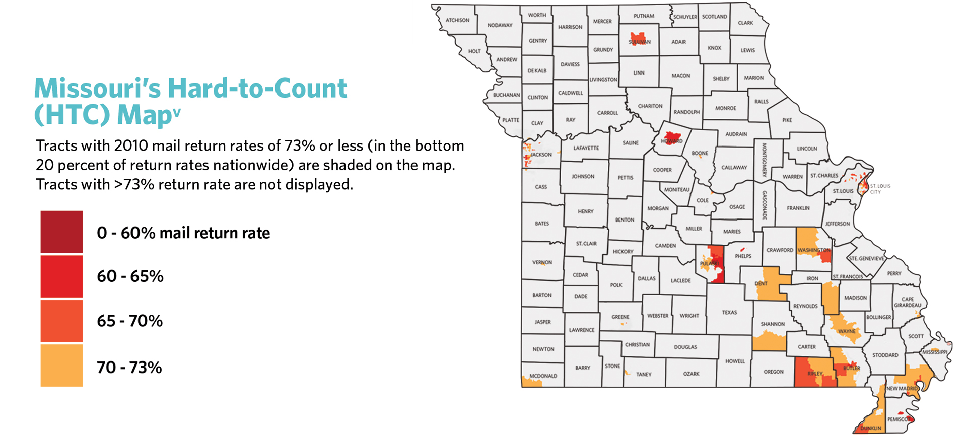
Traditionally Undercounted Populations
Low income
Rural
Renters/multifamily housing
Communities of color
Limited English proficiency
Children under 5
Homeless
Older adults
People with disabilities
Notes:
Approximately 9 percent of Missouri’s population lived in undercounted neighborhoods during the 2010 Census. These are census tracts where almost a quarter or more households did not mail back their Census questionnaires in 2010. Without concerted efforts, these households are at a higher risk of being missed in the 2020 Census.
In 2016, 20.7 percent of households had either no internet subscriptions or dial up only access according to American community survey data: Hard-to-Count Maps, Missouri, https://www.censushardtocountmaps2020.us/ (use this map to drill down further)
Children are actually the hardest to count population, with about 4.5 million children living in traditionally undercounted communities. Can be from poverty, complex living arrangements, language barriers – several programs directly benefit children at risk (CHIP, Head Start, Foster Care, Child Care, Special Education Grants). In 2010, an estimated 1 million children under 5 didn’t show up in the survey.

Slide 8
New in 2020
Considerations
Opportunities
First high-tech Census
Fewer canvassers and limited outreach
Rural communities face multiple barriers
Broadband
Canvassing difficulties
P.O. Box usage
Some households with limited internet access or older adults will get the Census questions by mail or hand-delivered to their home.
The Census will be available online and by phone in 13 languages. The paper version for mailing will be available in English and Spanish.
Notes:
This is the first high-tech census to use the internet as a primary response method. That means households must have adequate access to technology, and high speed internet. Approximately 20 percent of Missouri households do not have access to high-speed internet or broadband. This is an issue in our rural areas but it also spreads to urban and suburban areas as well.
Census will ask most households to respond online first, BUT will still have paper forms and a phone number.
There will be scaled back canvassing efforts with about 200k fewer field staff across the country and half as menu local census offices. So it’s on us to make sure we educate our neighbors about the Census.
Challenges in rural communities (remove if not part of a rural community)
Broadband and high speed internet access is worse is some of our more rural areas
It’s harder for Census bureau staff to reach individuals in rural and remote communities where the population is less concentrated – takes more time and need to consider effective outreach strategies
The Census Bureau will not send information to PO boxes because it is not a residence. Some households that relay on PO boxes will be reached through the update/leave or update/enumerate processes where Census Bureau staff will either drop off paper forms (update/leave) or reach out directly and respond in person (update/enumerate). Type of Enumeration Area Viewer map
The Census Bureau has also made changes to make the Census accessible to more people.
Even though it is the first high-tech Census, some households will get paper questionnaires.
And people will be able to respond in many more languages – English and 12 others online. There will also be guides in 59 languages.

Slide 9
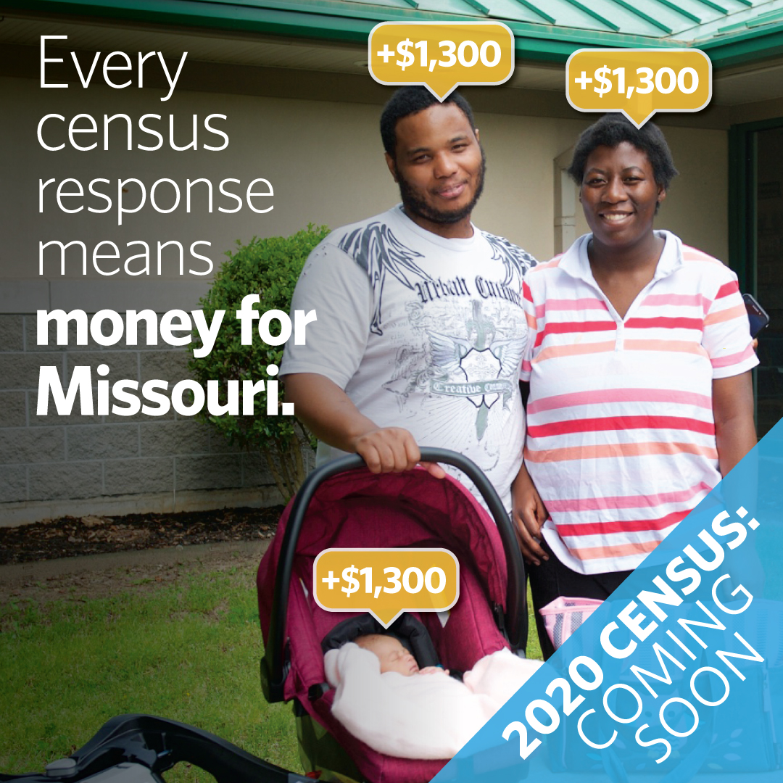
What’s Happening in Insert Community
Include information about your efforts to get out the count in your community.
Invite people to get involved in your efforts. Give them simple and easy steps!

Slide 10
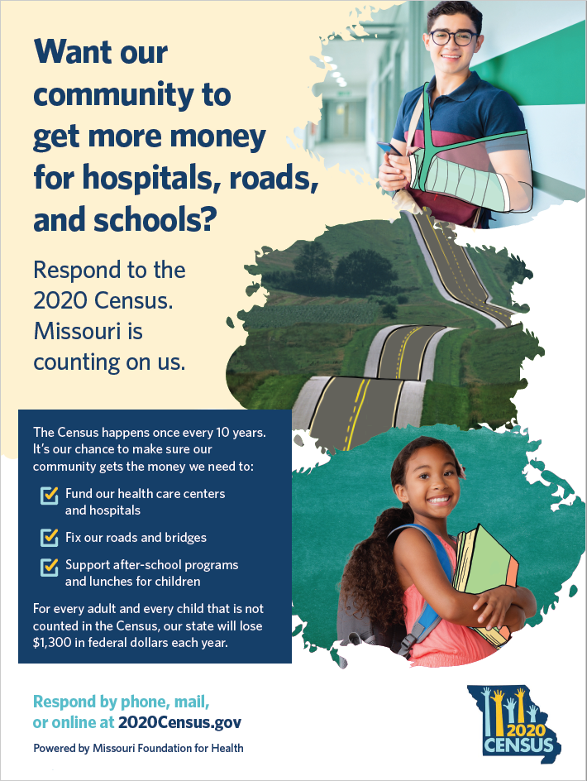
What’s Happening Statewide
Missouri Complete Count Committee (CCC)
Through Gov. Parson’s office
Statewide media and messaging
Partner mapping tool
Event tracking
Notes:
The state is organizing efforts to get out the count through the Missouri Complete Count Committee, led by Governor Parson’s office. They will be running some advertising and use coordinated messaging.
Partner mapping and event tracking found at https://missouricounts2020-mooa.hub.arcgis.com/

Slide 11
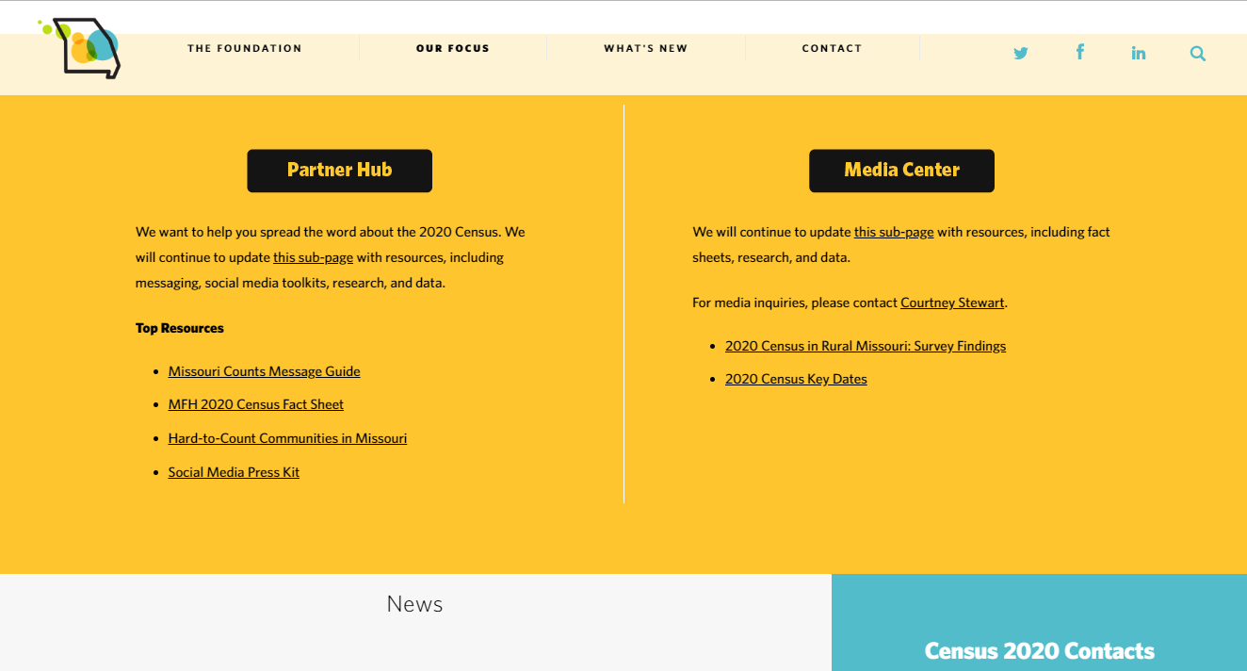
Learn More & Get the Word Out!
Missouri Foundation for Health resources: www.mffh.org/census
Social Media Toolkit
Fact Sheet
Promotion Materials
Frequently Asked Questions
Hard-to-Count Map
And other data resources
Notes:
The most important thing you can do is respond to the Census! But right after that comes spreading the word. We want to make sure EVERYONE knows about the 2020 Census because we need everyone to respond. That’s the only way Missouri gets the funding and representation we deserve.
Of course you can simply talk to your neighbors. But if you have a way to get the word out, like social media channels for your organization, hanging flyers, or even talking to your parishioners, Missouri Foundation for Health has resources that are easy to use. Visit mffh.org/census to check out these resources in the Partner Hub.

